Slide 1
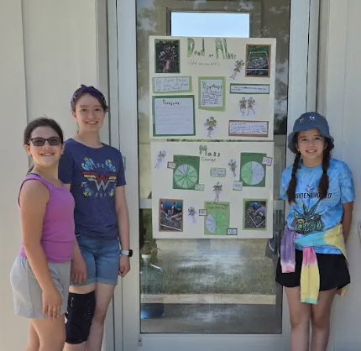
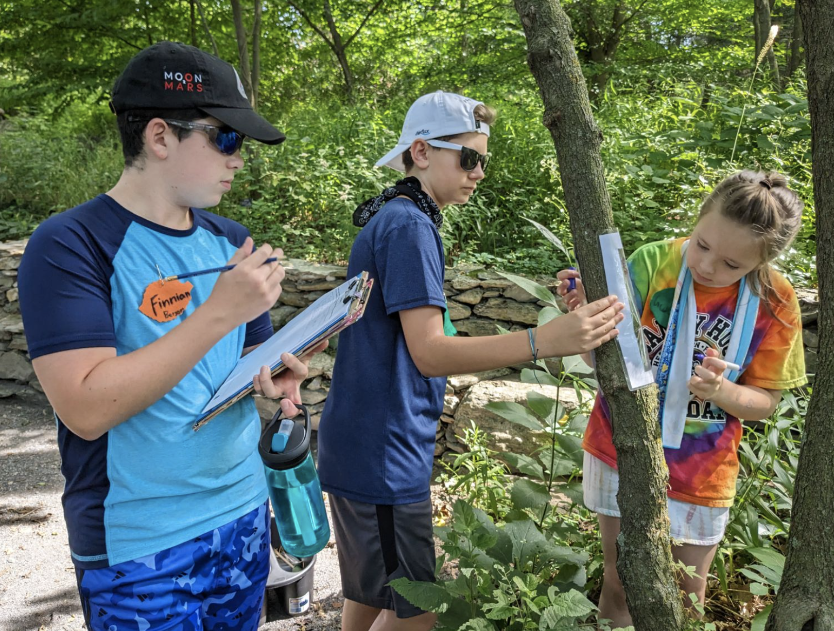
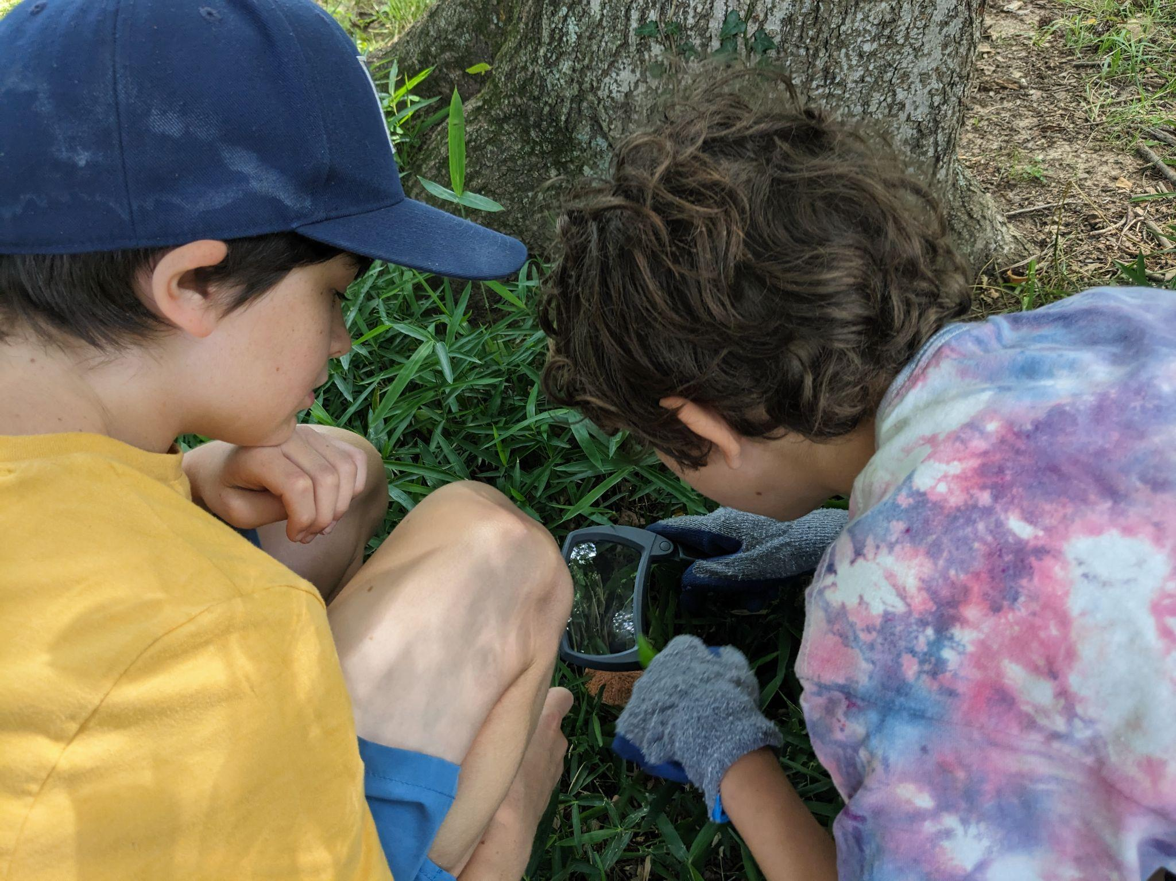
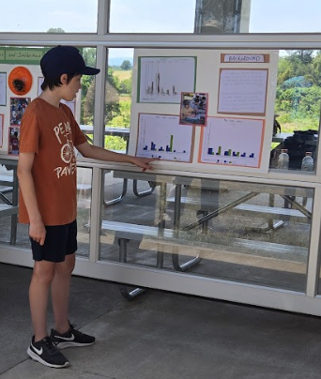
Data Cycling:
Mathing Out the Right Course
VAEE Annual Conference
February 9 -11, 2025
Hotel Roanoke, Virginia ​
Stefany Feldbusch,
M. Ed. E. E. in May 2025…Yay!
Environmental Educator
Blandy Experimental Farm
stefanyfeldbusch@virginia.edu
Emily Ford, M.S.S.E,
Lead Environmental Educator
Blandy Experimental Farm
emilyford@virginia.edu
Notes:
Welcome! - Stefany will introduce the presentation title and introduce herself in a few sentence. Emily will introduce herself.

Slide 2
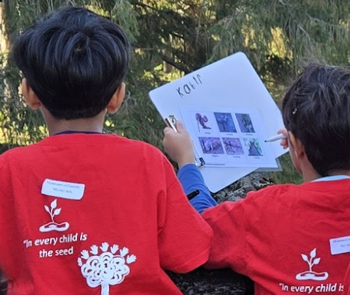
Session Agenda
Introduction
Session objective
Accessing the VA SOLs
Key Differences at each grade level
Engage in an investigation
Examples of the data cycle at different grade levels
Informal Education and the Data Cycle
Blandy High School Programs
Closing

Slide 3
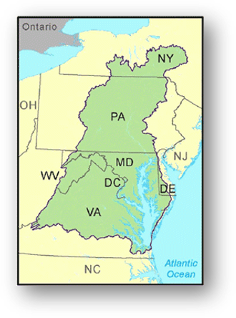
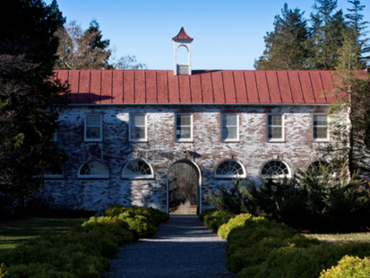
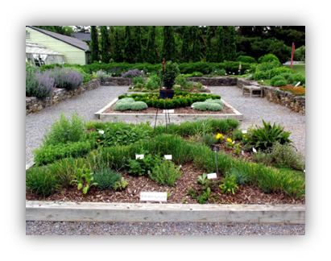
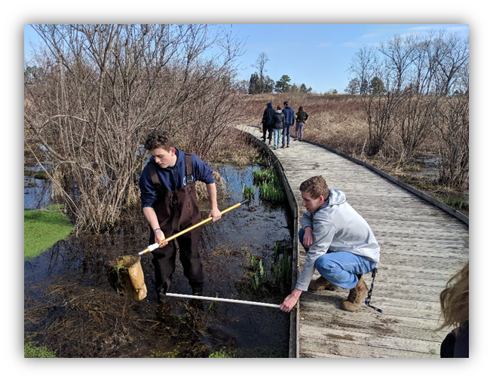
University of Virginia’s Blandy Experimental Farm &
The State Arboretum of Virginia
Field ecological research station
The State Arboretum of Virginia

Slide 4
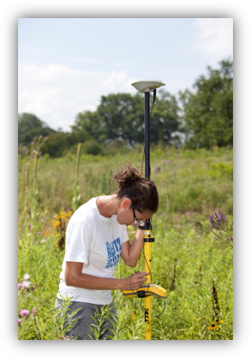
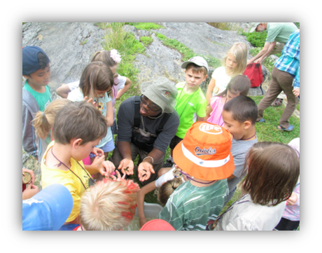
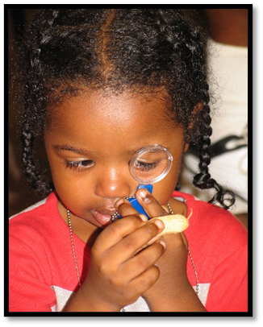
University of Virginia’s Blandy Experimental Farm &
The State Arboretum of Virginia
Blandy’s Mission: To increase understanding of the natural environment through research and education

Slide 5
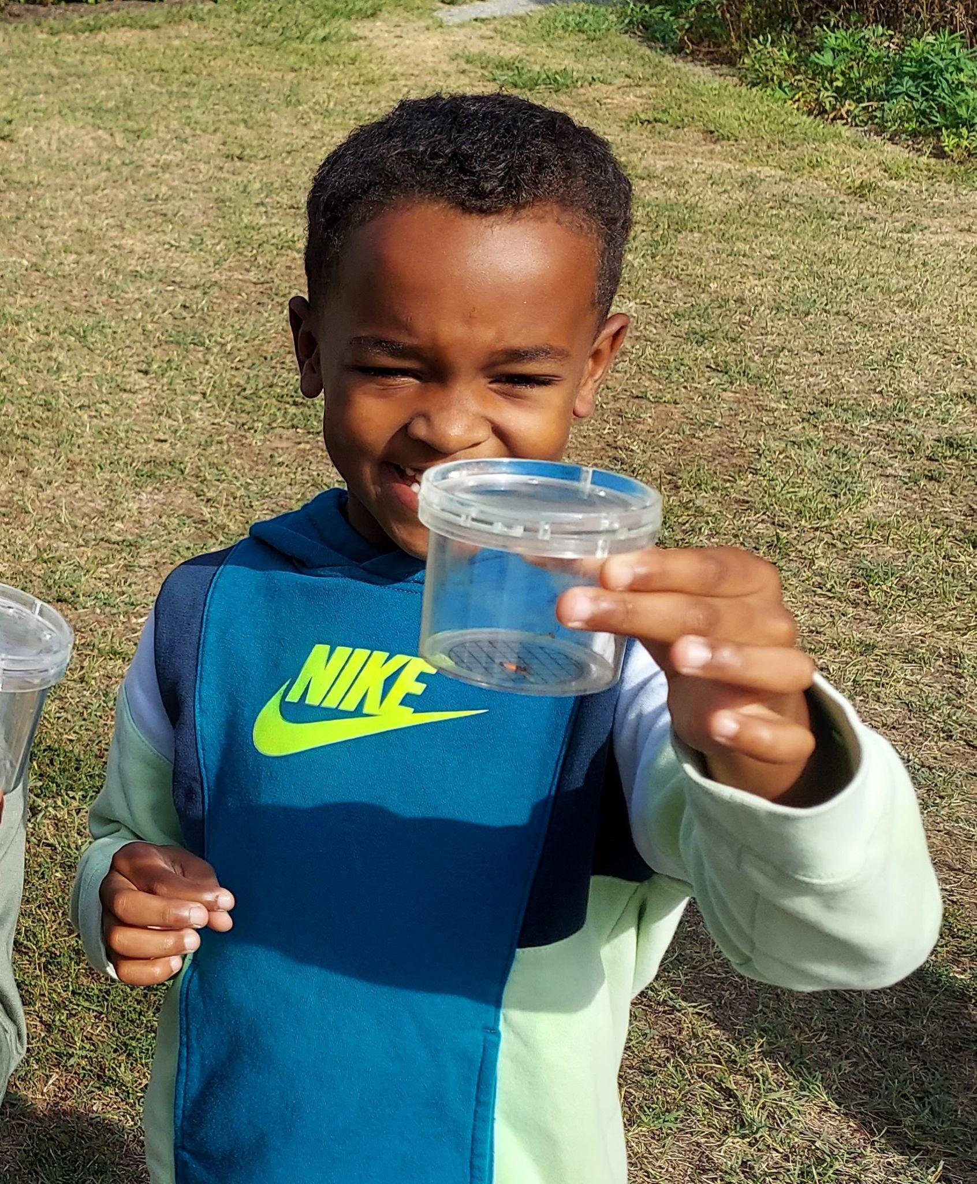
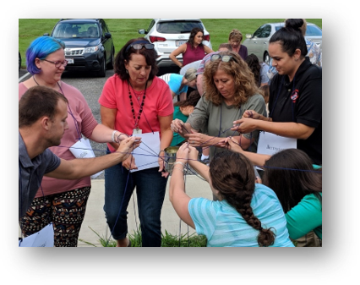
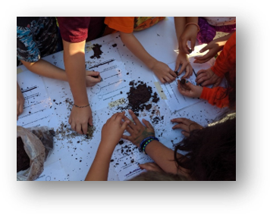
Education Outreach
Hands-on, outdoor, experiential field investigations
​
~7000 PK-12 students per year​
Inquiry, Science Process and Skills focused programs​
Correlated to state and national standards​
Field-based STEM Learning ​
Teacher professional development

Slide 6
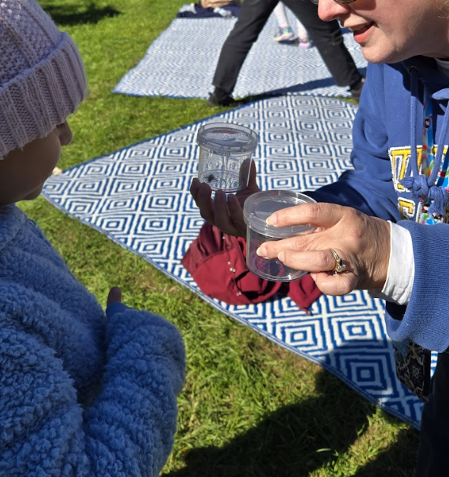
Session Objective
During this session you will learn how to integrate the 2023 VA Mathematics SOLs into student inquiry-based learning of the data cycle. There will be a focus on authentic data collection.
The 2023 VA Math SOLs address how students apply the data cycle by:
posing questions
collecting data
organizing and representing data
analyzing data
communicating results

Slide 7
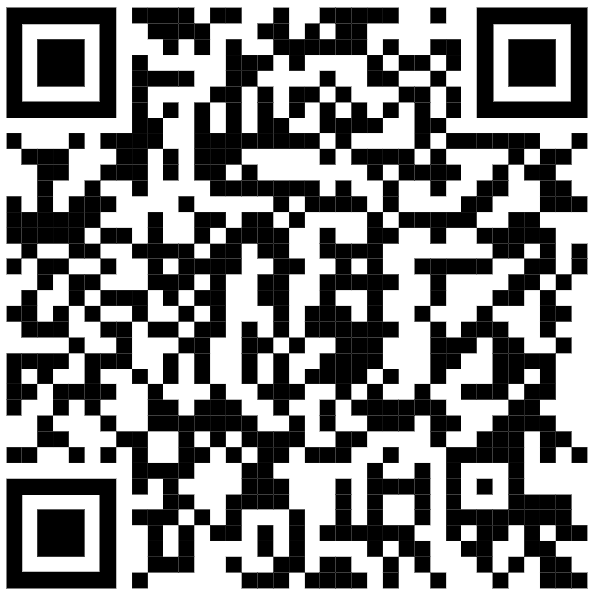
Accessing the 2023 VA Mathematics SOLs
Specific K-8th grade standards, addressing the data cycle, are found under the Probability and Statistics section in each grade.
https://www.doe.virginia.gov/home/showpublisheddocument/48908/638672685417270000
Notes:
Take a photo of this QR code. We will not be diving into the standards in depth. As we mentioned, the goal is to give examples of authentic data collection and the data cycle in the standards.

Slide 8
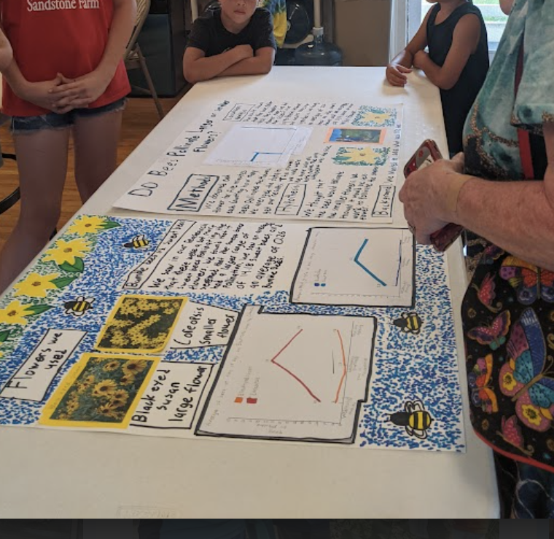
What are the key differences at each grade level?
How data is organized
and displayed
Depth of analysis
Questioning throughout
the data cycle
The number of data points/ categories

Slide 9
Early Elementary Application of the Data Cycle
According to the 2023 VA Math SOLs
Grade Level | Number of data points/ categories | Collecting/ Displaying Data | Questioning
K | 25 or fewer data points; no more than 4 categories | sorting into groups; object graphs; picture graphs (vertically or horizontally) | Pose questions, given a predetermined context, that require the collection of data
1st | 25 or fewer data points; no more than 4 categories; one or two attributes | tallying; T-charts; object graphs; picture graphs; tables | Pose questions, given a predetermined context, that require the collection of data
2nd | 25 or fewer data points; No more than 6 categories | lists; tables; charts; tallying; pictographs (Symbols can represent up to 2 data points); bar graphs; graphs with title and labeled axes (increments increase by 1 or 2) | Pose questions, given a predetermined context, that require the collection of data
Notes:
S- explain process of creating the chart from the mathematics SOL

Slide 10
Upper Elementary Application of the Data Cycle
According to the 2023 VA Math SOLs
Grade Level | Number of data points/ categories | Collecting/ Displaying Data | Questioning
3rd | 30 or fewer data points; No more than 8 categories | Polls; observations; tallying; pictographs (Symbols can represent 1,2,5 or 10 data points); bar graphs; graphs with title and labeled axes (increments increase by 1, 2, 5, or 10) | Formulate questions that require the collection or acquisition of data
4th | No more than 10 data points on line graphs | Line graphs; graphs with title and labeled axes (whole number increments) | Formulate questions that require the collection or acquisition of data
5th | 30 or fewer data points | stem-and-leaf plot (stems and leaves listed in ascending order); Line plot/ dot plot (may include whole numbers, fractions, or decimals); find mean, median, mode, and range; include keys | Formulate questions that require the collection or acquisition of data

Slide 11
Middle School Application of the Data Cycle
According to the 2023 VA Math SOLs
Grade Level | Number of data points/ categories | Collecting/ Displaying Data | Questioning
6th | Determine factors that ensure that the data collected is a sample that is representative of a larger population | Circle graphs (denominators of 12 or less or those that are factors of 100); justify which graphical representation best represents the data | Formulate questions that require the collection or acquisition of data
7th | Determine how sample size and randomness will ensure that the data collected is a sample that is representative of a larger population | Histograms; justify which graphical representation best represents the data | Formulate questions that require the collection or acquisition of data
8th | 20 or fewer items in plots; Determine whether two events are independent or dependent | Box plots; scatterplots; describe how outliers affect data distribution; justify which graphical representation best represents the data | Formulate questions that require the collection or acquisition of data;Identify components of graphical displays that can be misleading

Slide 12
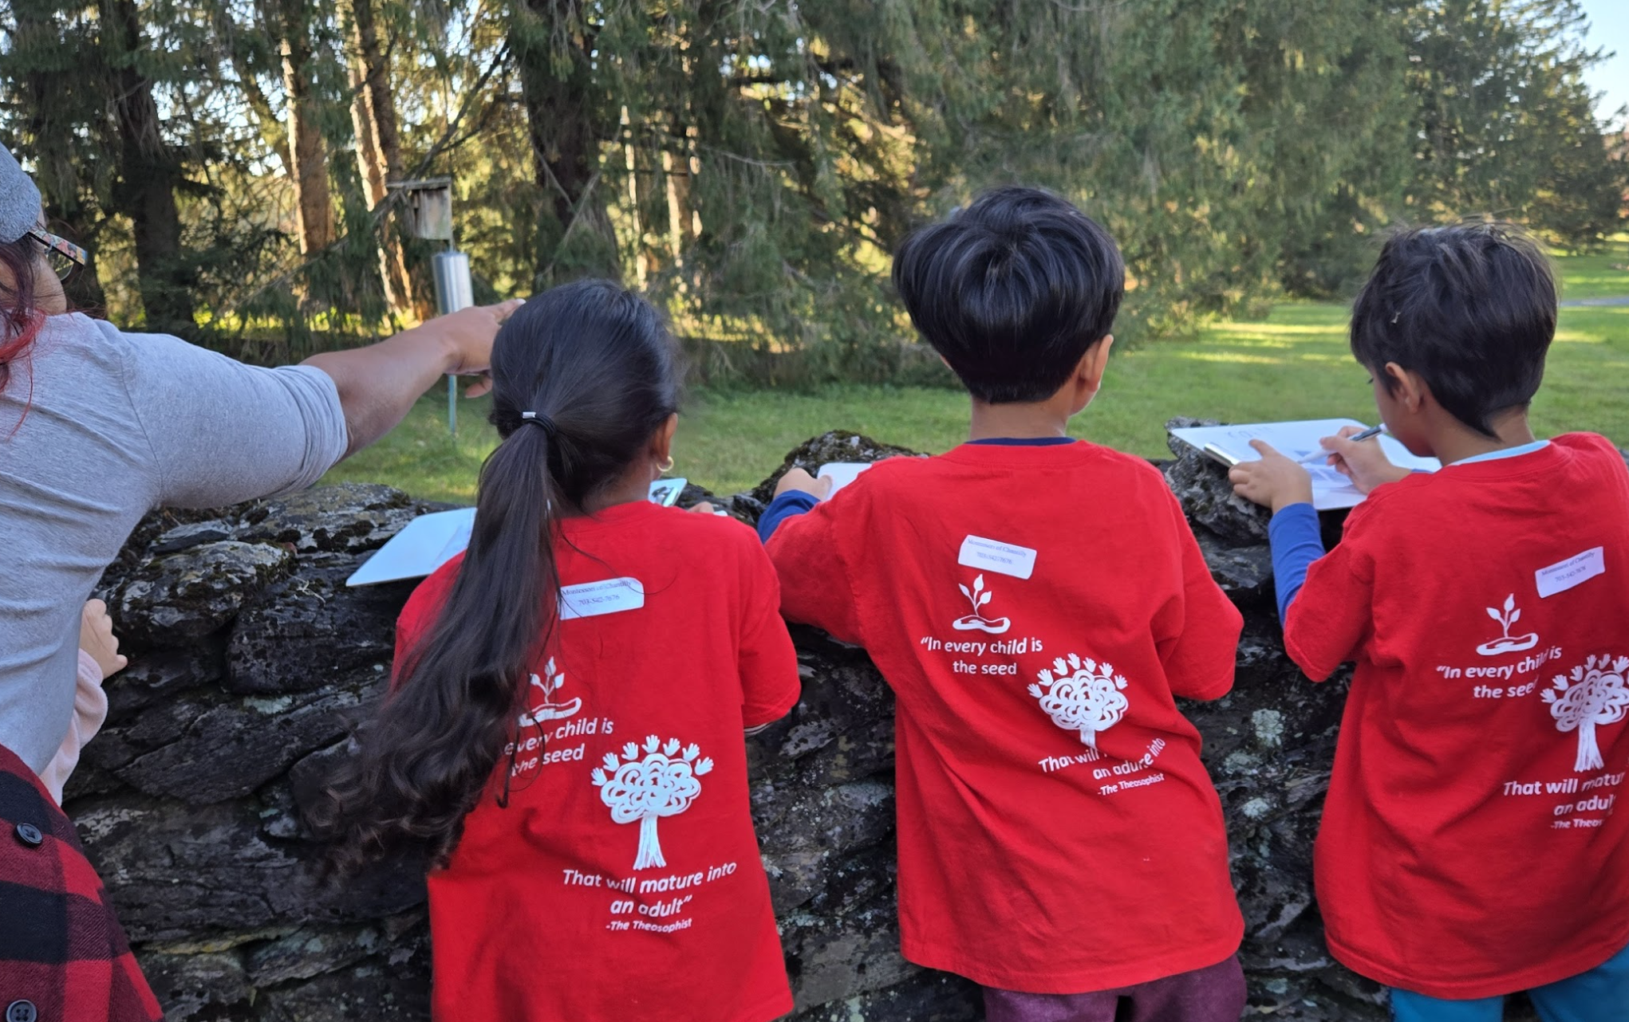
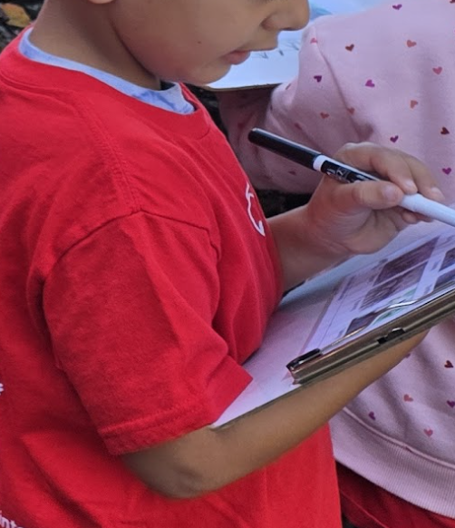
Example of K-2nd Data Collection
Option: Submit results to Project Squirrel
Students tally squirrel behaviors as they observe them in nature.
Notes:
May need to limit to 4 categories for K and 1st grade; Kindergarten could have the option of checking the box when they observe the behavior (from experience, many kindergarteners are capable of tallying); Blandy educators usually check with the classroom teacher to confirm ability level of students

Slide 13
Let’s head outside to observe squirrel behavior!
Activity expectations:
Collect data as a K-2nd grader.
Discussion: How could this activity be adapted for a 3rd-5th grader? 6th-8th grader? High Schooler?

Slide 14
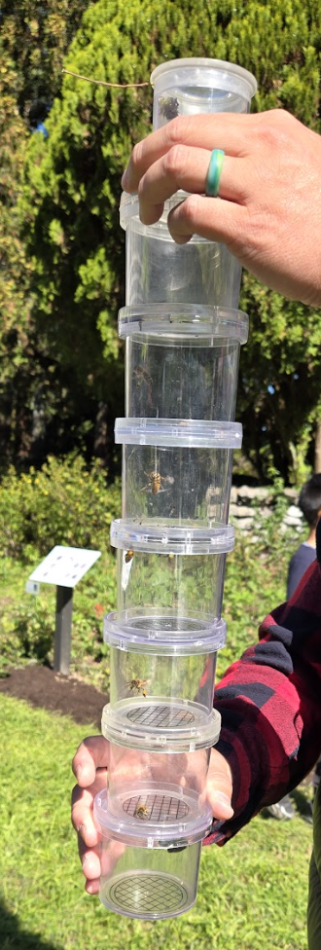
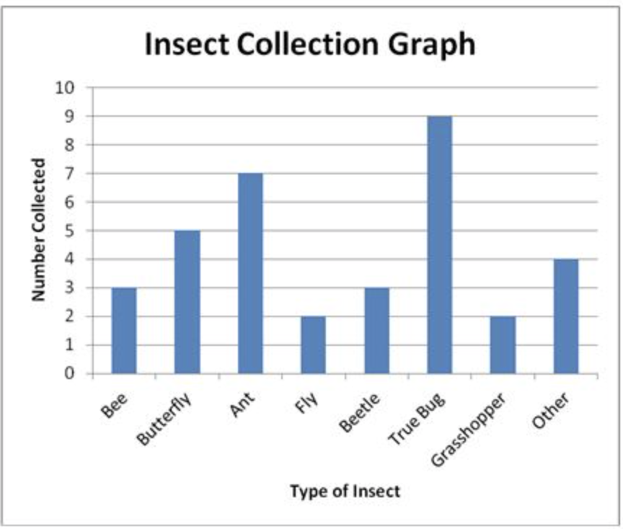
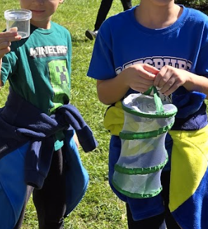
Example of 2nd-3rd Grade Data Collection
Students collect insects in the pollination garden and create a class bar graph displaying their data.
Notes:
Option to create a class graph, on a large whiteboard outdoors, immediately after data collection OR record totals and students can create a graph when they get back to school; might need to limited to 6 categories for 2nd grade

Slide 15
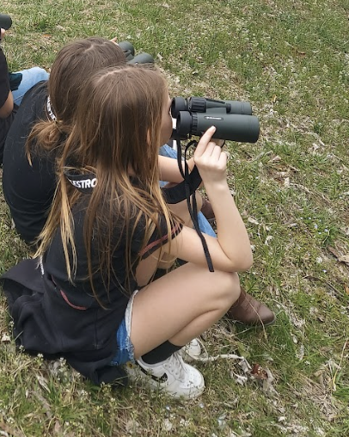
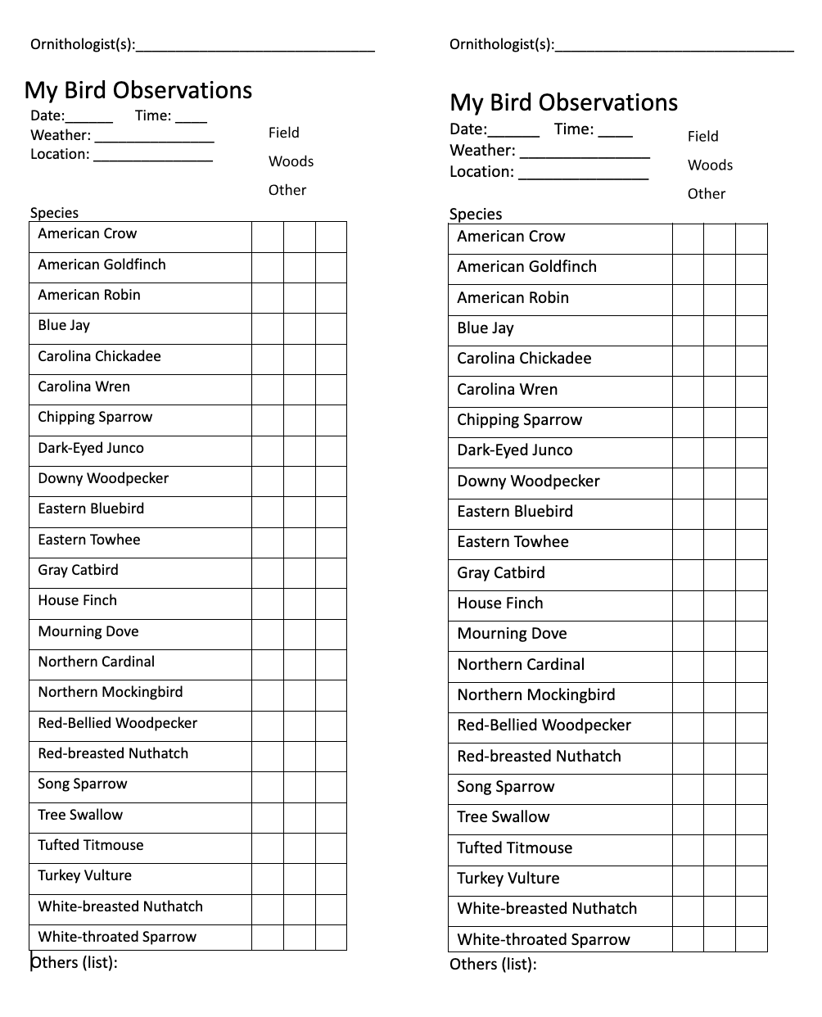
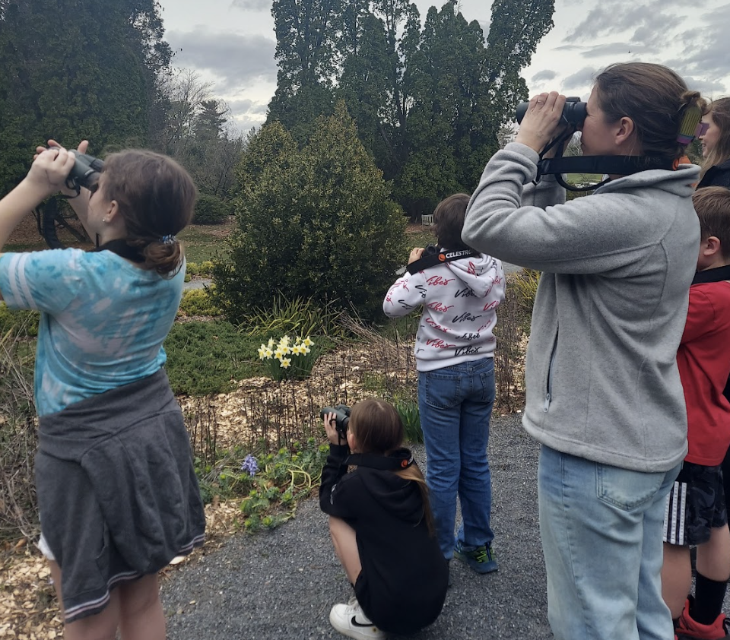
Example of 3rd-4th Grade Data Collection
Students record the birds they identify during a birding walk.
Students create a graph based on their data.
Option: Submit results to eBird.
Notes:
Option to create a graph at school based on data collected; submit data to eBird

Slide 16
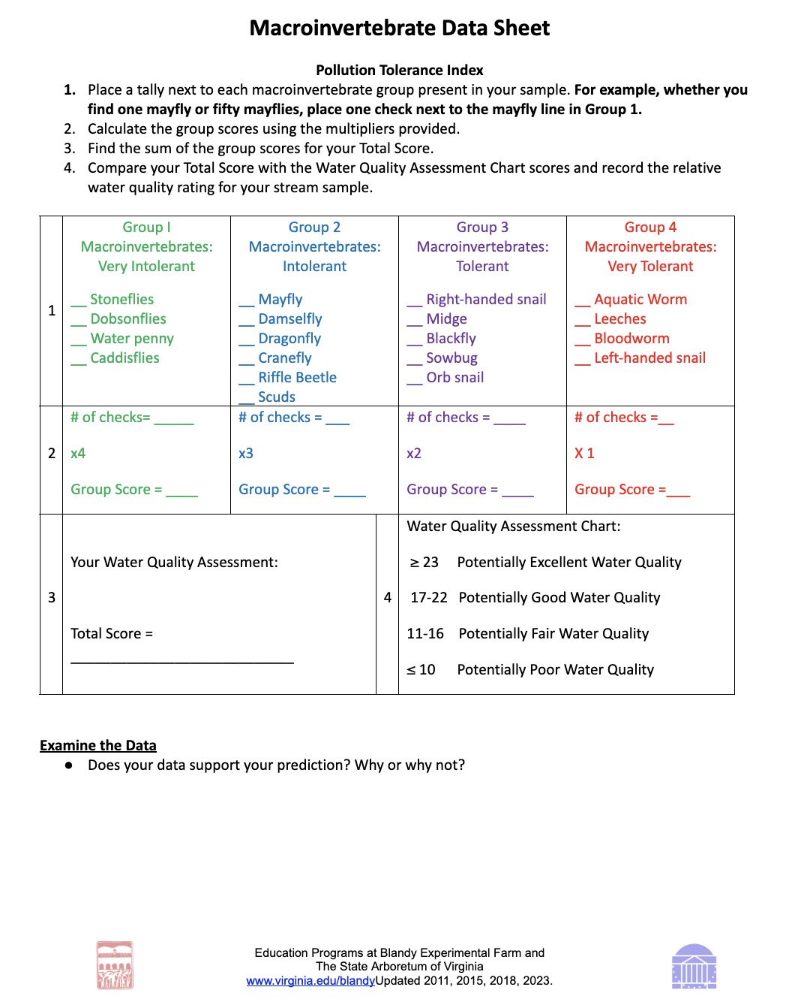
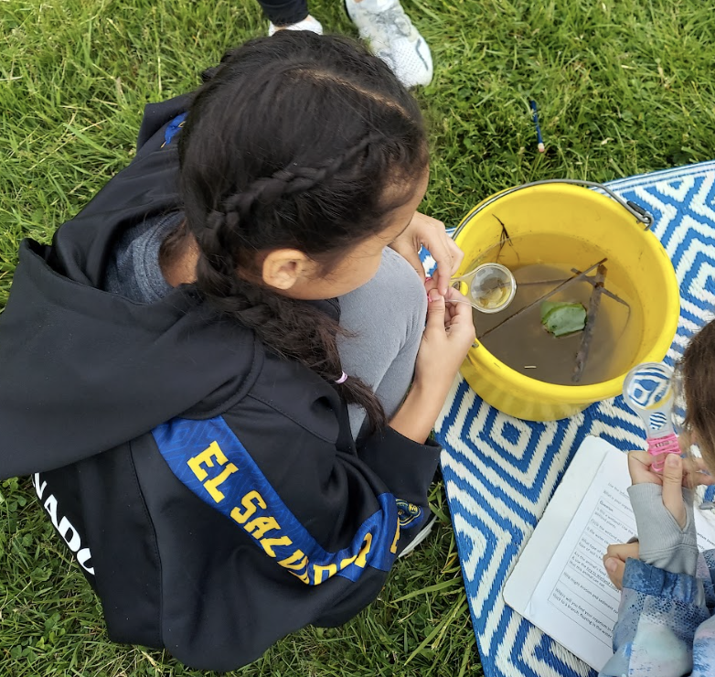
Example of 6th Grade
Data Collection
Students record the quality of water based on the pollution tolerance of macros they identified. Students create a graph to represent their data. Macro data is submitted to DWR.
Notes:
Circle graphs representing the percentage of macros found at each tolerance level is one way data can be represented. Macro data is submitted to Department of Wildlife Resources.

Slide 17
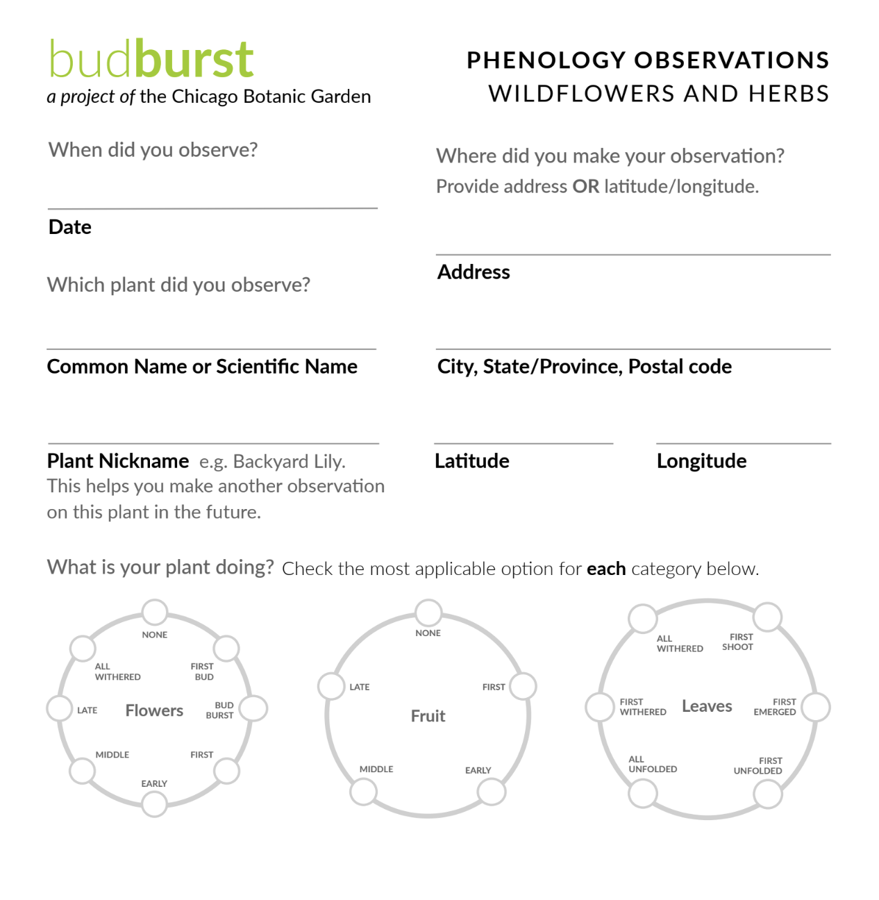
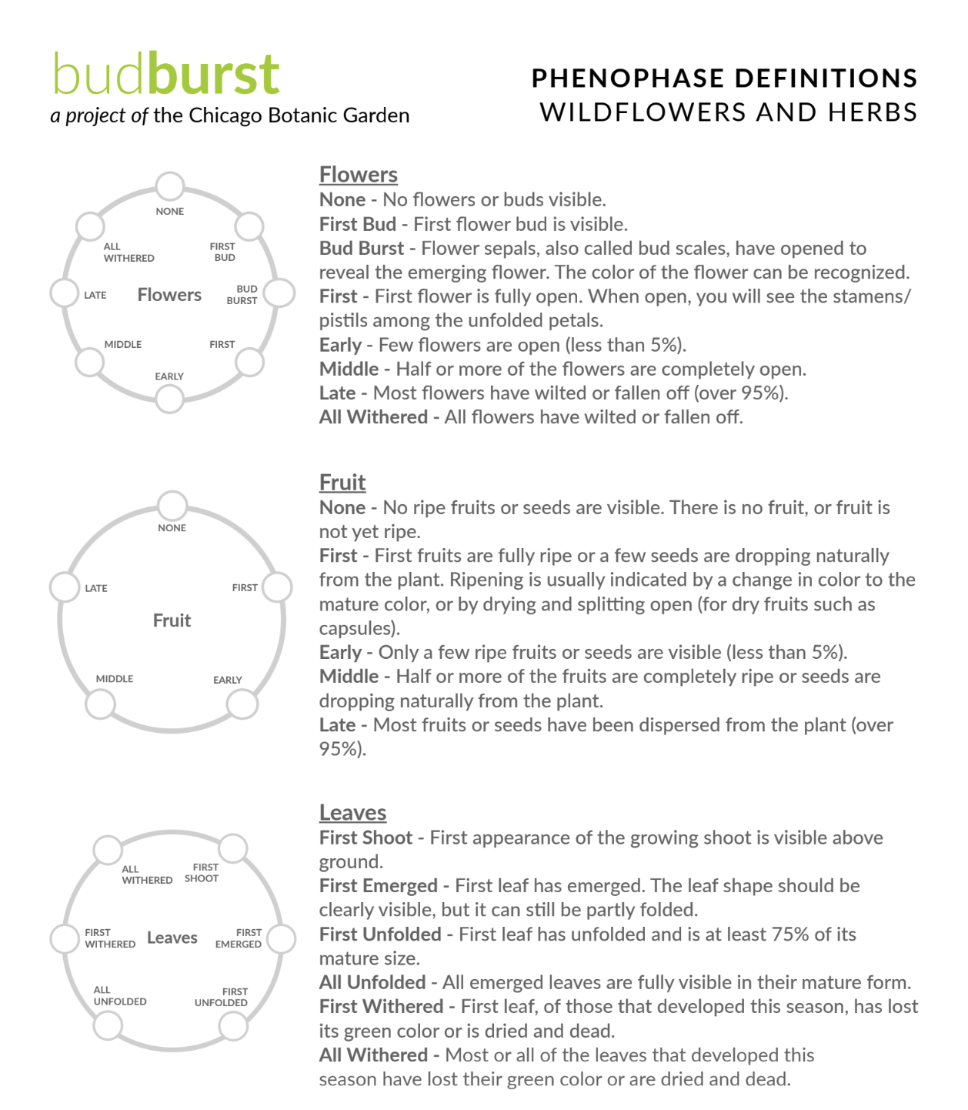
Example of 8th Grade Data Collection
Project Budburst is a Community Scientist Project of the Chicago Botanical Garden.
Notes:
Students collect phenological data on herbaceous plants, trees, and shrubs. Students can collected their data and compare it to data collected by other citizen scientists. They also have the option to collected data over an extended period of time and analyze that data. They can even compare temperature, rainfall totals, pollution index etc. to phenological data collected on Budburst.

Slide 18
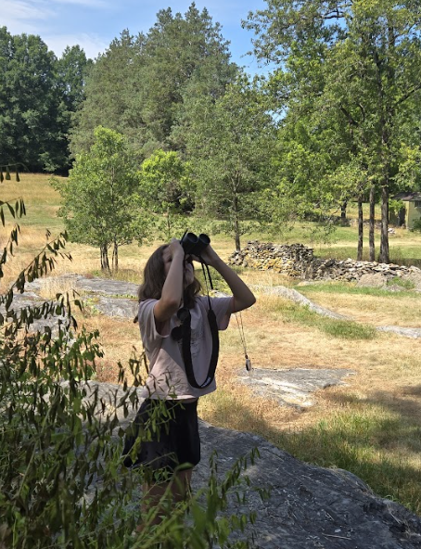
Blandy Eco Explorers
Camp
Campers in 6th-8th grade spend one week out of the summer completing an ecological research project. A research forum takes place at the end of the week when they share their results to parents, Blandy staff, and visiting scientists. They work in small groups:
formulating a research question
designing an observational study/ experiment
collecting data
designing poster presentations, displaying their findings on graphs/ charts/ plots

Slide 19
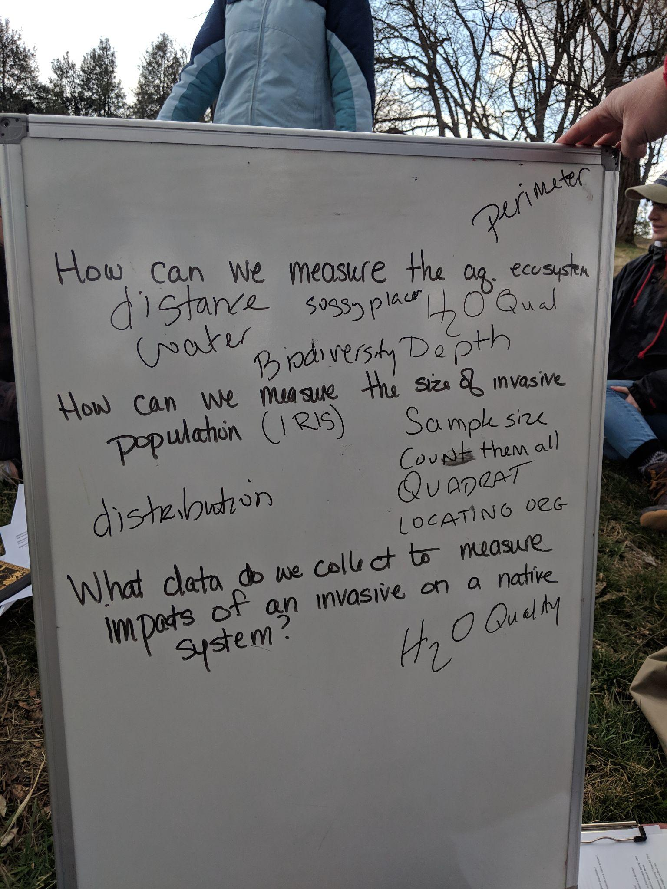
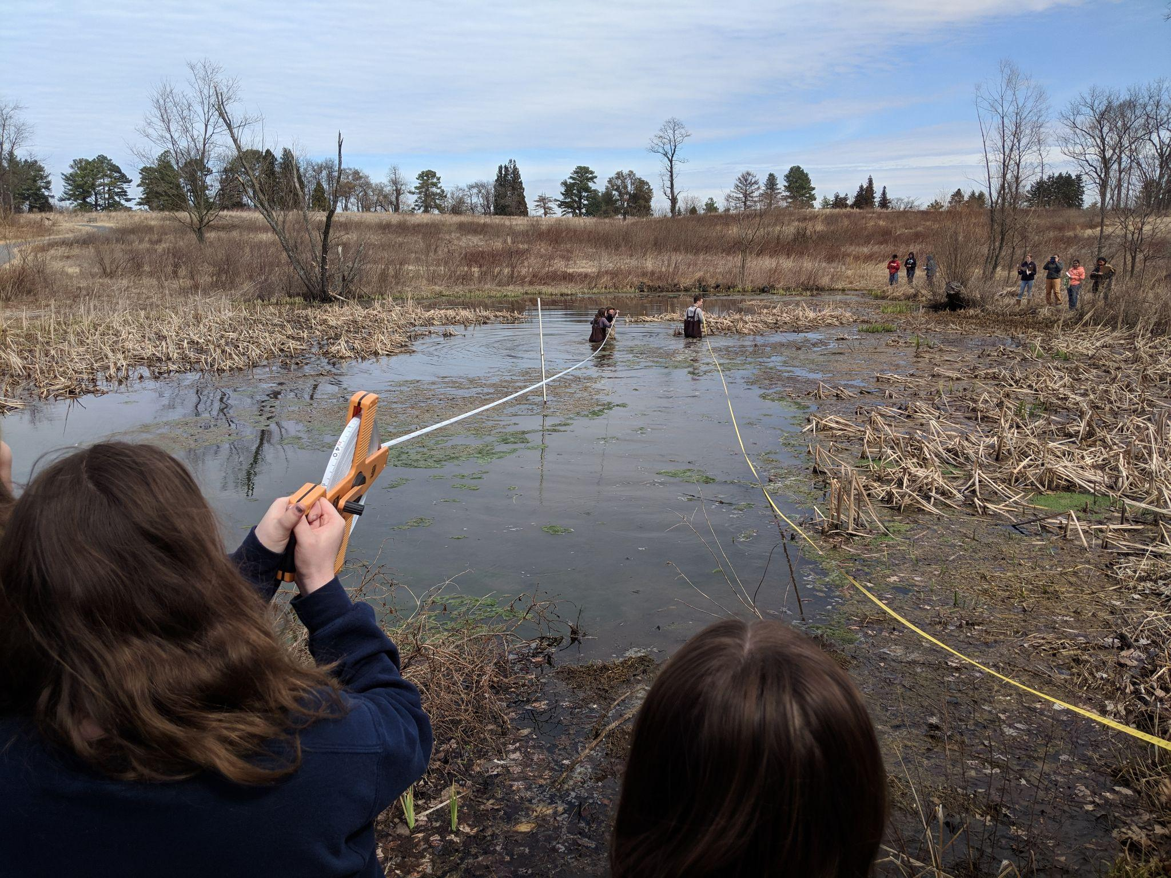
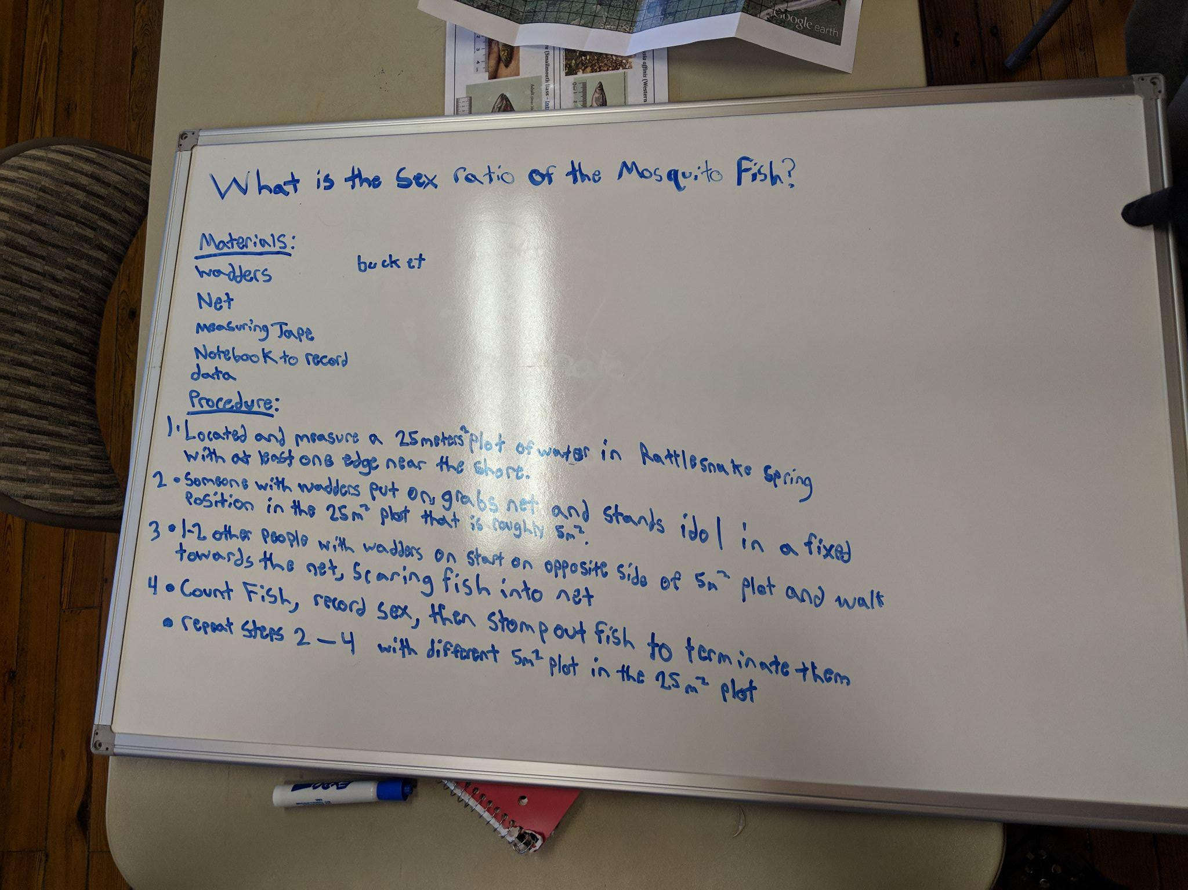
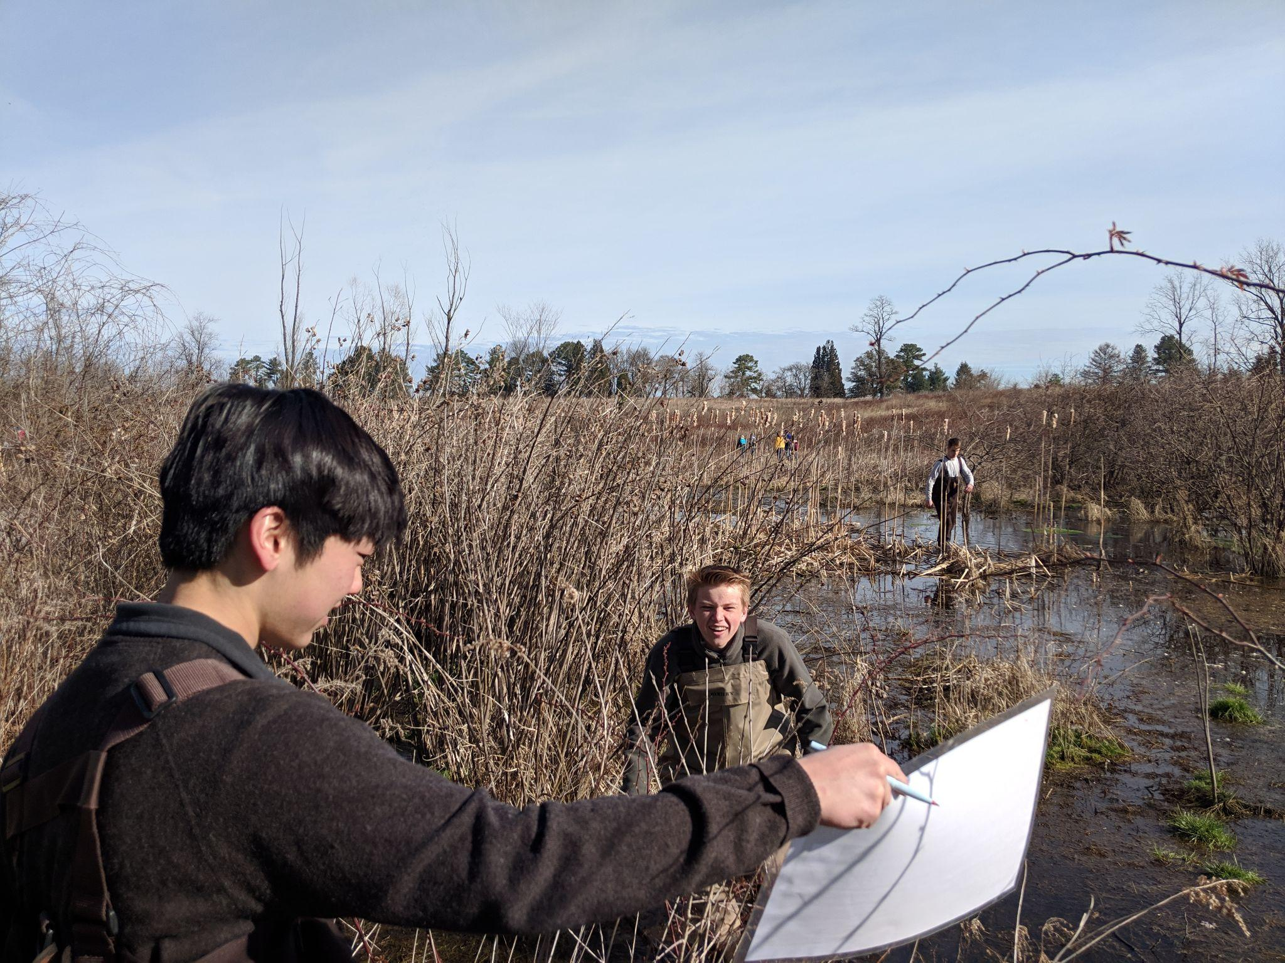
Blandy High School Programs
Day long scientific investigation …

Slide 20
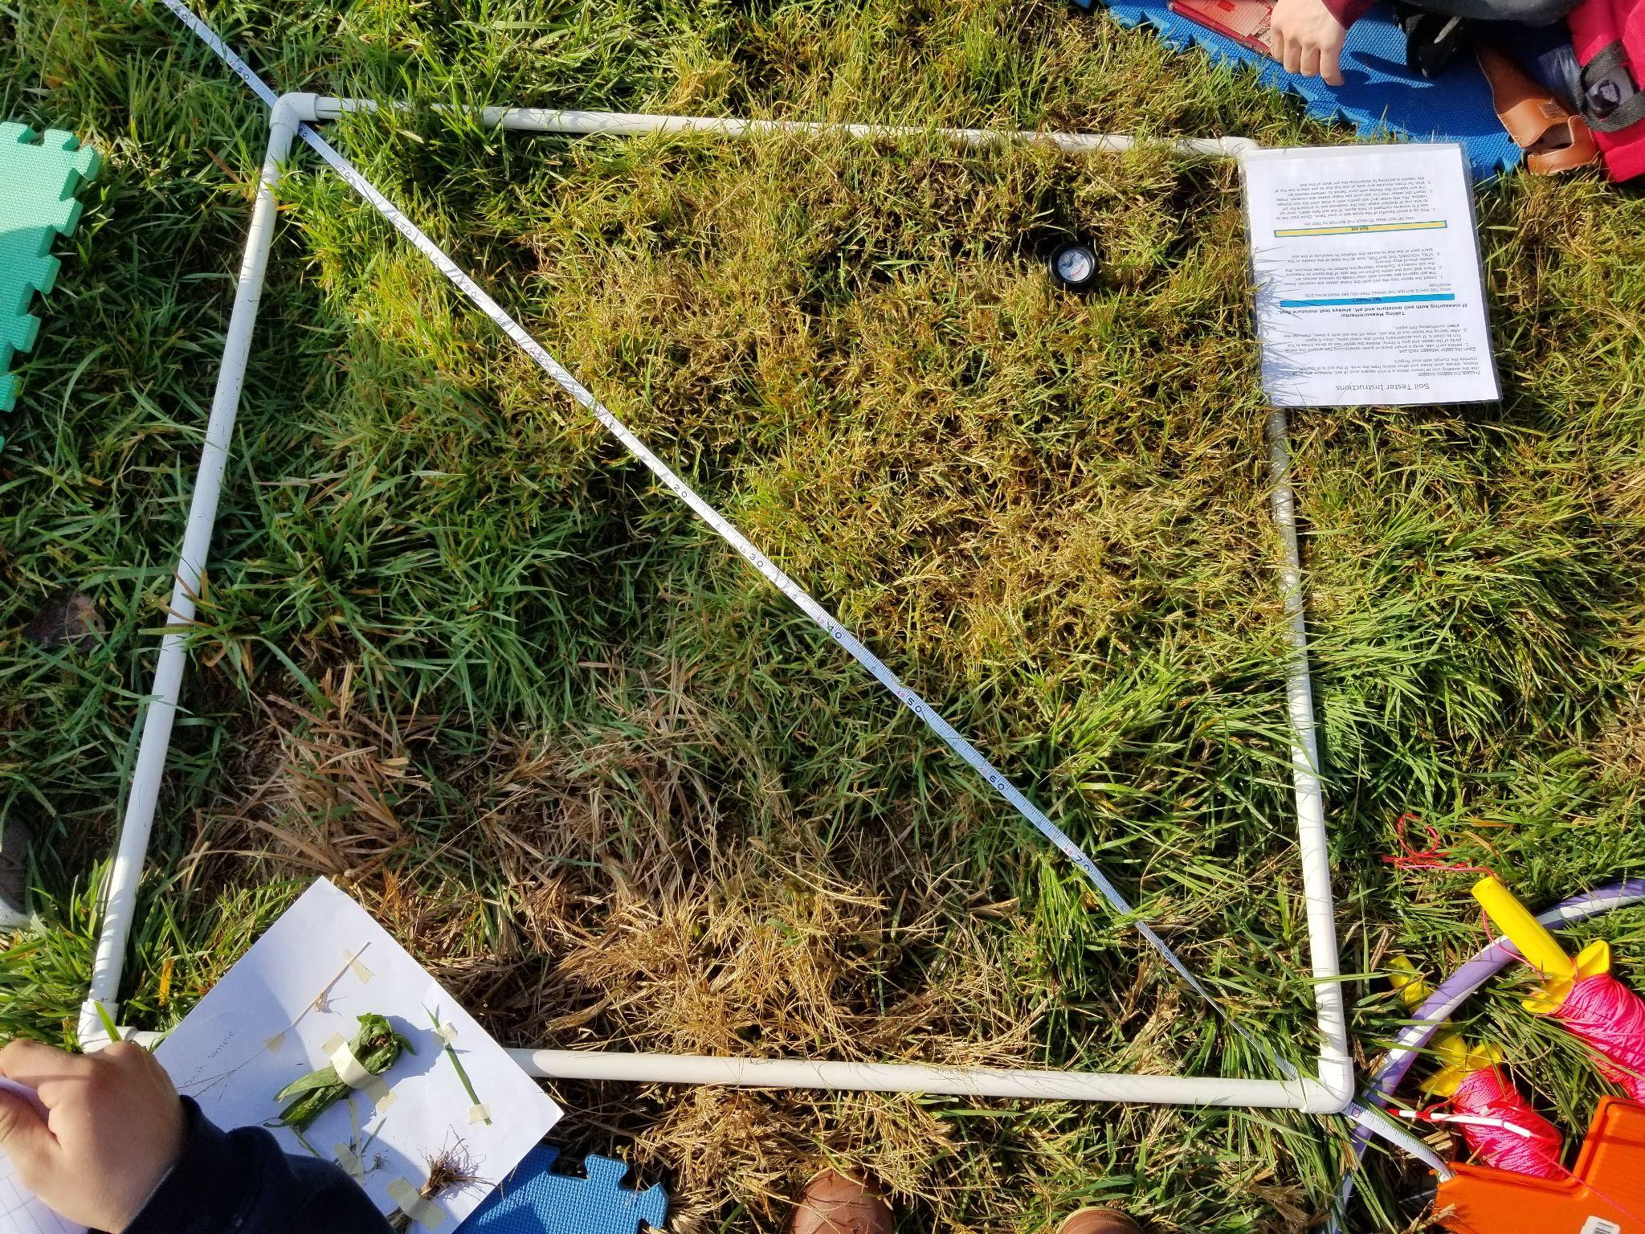
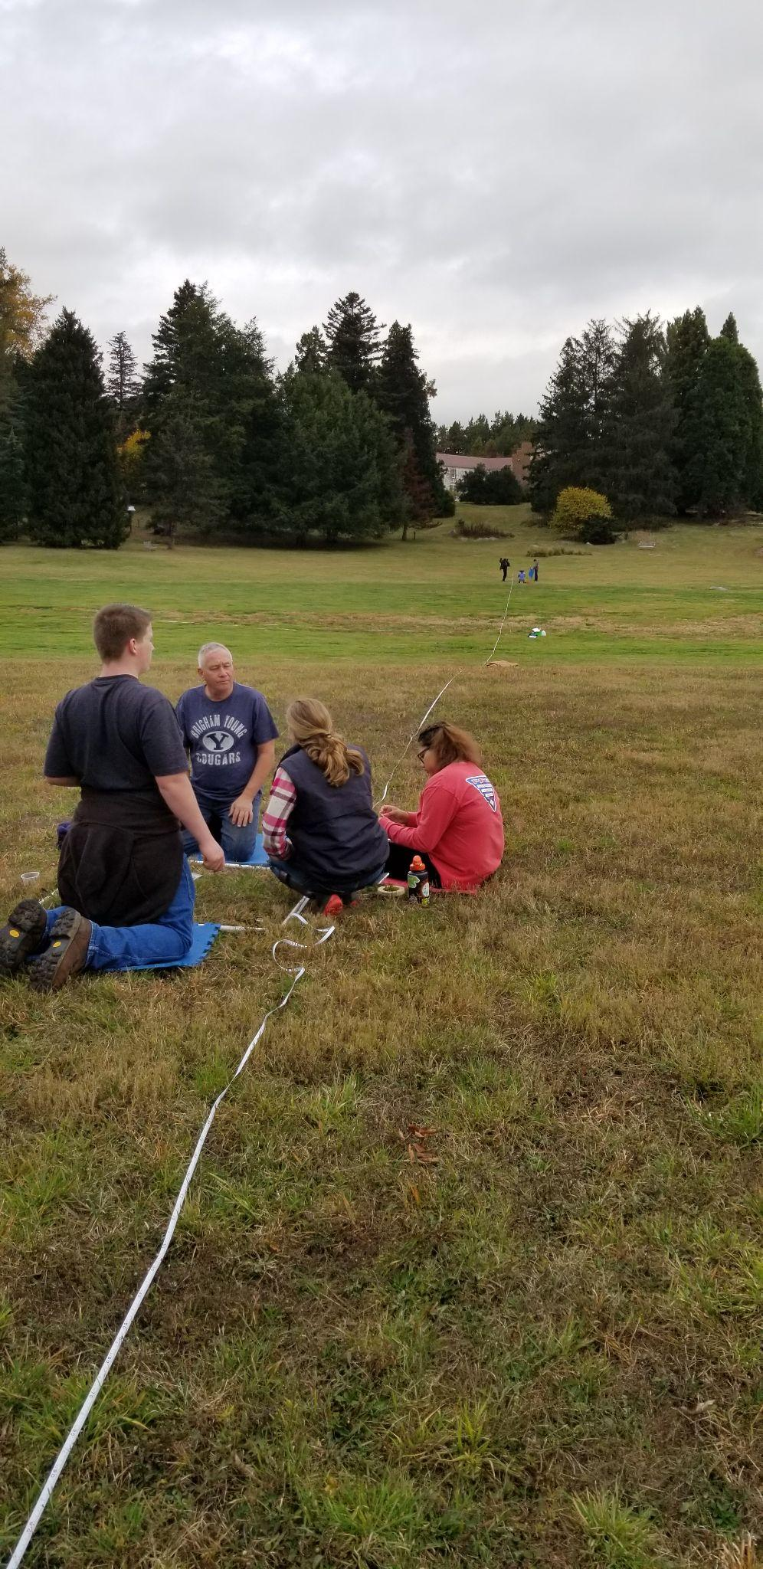
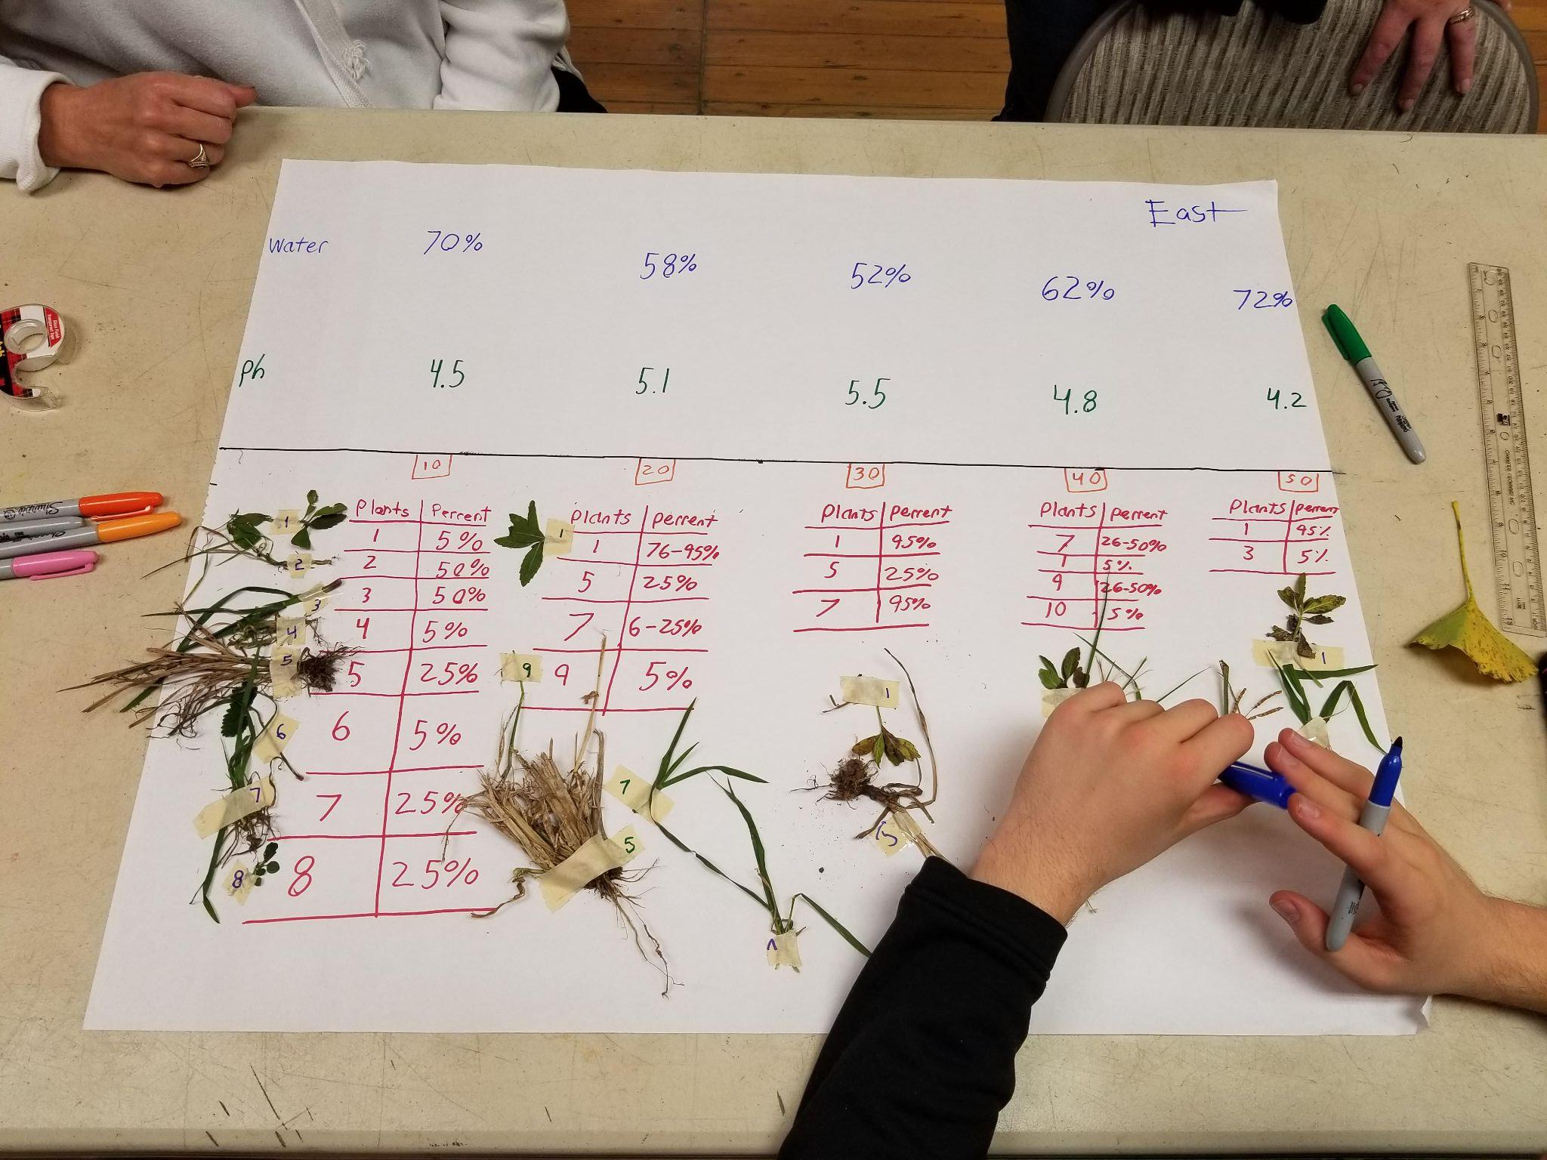
AFDA: Soil moisture, pH and diversity along a transect.

Slide 21
Course | Number of data points/categories | Collecting/Displaying Data | Questioning
Algebra 1 | 30 or fewer data points, determine method to collect a representative sample, to answer a question. | Scatterplot, use available technology to determine whether a linear or quadratic function would represent the relationship | Formulate Questions that require the collection of bivariate data
Algebra, Functions & Data Analysis | Investigate, describe, and determine the best sampling techniques, such as simple random sampling, stratified sampling, and cluster sampling | Collect or acquire bivariate data. Investigate, describe, and determine the best sampling techniques, such as simple random sampling, stratified sampling, and cluster sampling | Formulate investigative questions that require the collection or acquisition of bivariate data, where exactly two of the variables are quantitative.
Algebra II | Collection or acquisition of a large set of univariate quantitative data Determine whether the relationship between two quantitative variables is best approximated by a linear, quadratic, exponential, or a combination of these functions. | Collect or acquire univariate data through research, or using surveys, observations, scientific experiments, polls, or questionnaires. Describe and interpret a data distribution represented by a smooth curve by analyzing measures of center, measures of spread, and shape of the curve. | Formulate investigative questions that require the collection or acquisition of a large set of univariate quantitative data or summary statistics of a large set of univariate quantitative data and investigate questions using a data cycle.
Descriptive Statistics | Compare and contrast two or more univariate data sets, numerically and graphically | Create and interpret graphical displays of data, including dot plots, stem plots, box plots, cumulative frequency graphs, and histograms, using appropriate technology | Investigate and explain the influence of outliers on a univariate data set. Investigate and explain ways in which standard deviation addresses variability

Slide 22
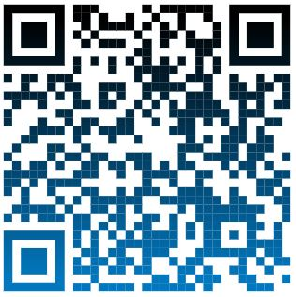
Thank you!
Stefany Feldbusch,
Environmental Educator
Blandy Experimental Farm
stefanyfeldbusch@virginia.edu
Emily Ford, M.S.S.E,
Lead Environmental Educator
Blandy Experimental Farm
emilyford@virginia.edu
https://blandy.virginia.edu/pk-12-education

Slide 23
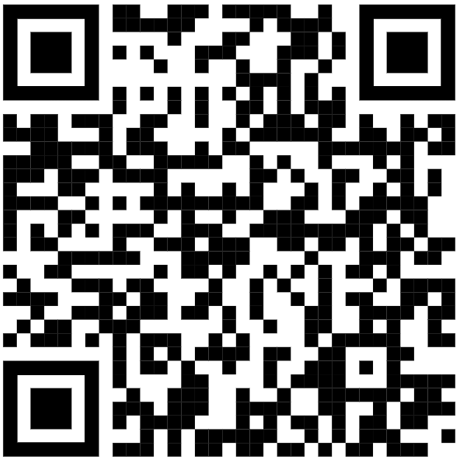
Accessing Project Squirrel
https://scistarter.org/form/project-squirrel
Notes:
Project Squirrel data collection is appropriate through high school.

Slide 24
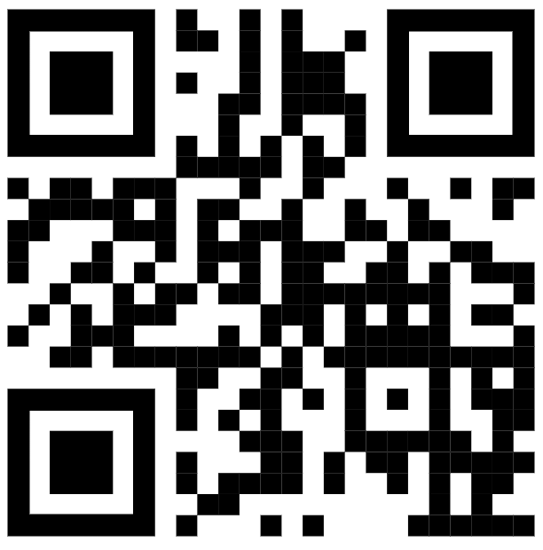
Accessing eBird
https://ebird.org/home
Notes:
eBird data collection is appropriate through high school.

Slide 25
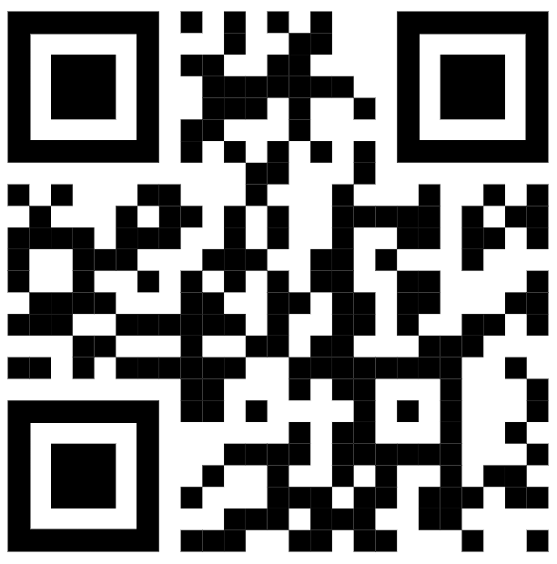
Accessing Budburst
https://budburst.org/
Notes:
eBird data collection is appropriate through high school.

